Slide 1


Brain Tumor Segmentation Using MRI and Deep Learning
Automated Glioma Detection Using BraTS Dataset
Submitted By:
Submitted To:
Priyanshu Kumar Singh (E23CSEU0807)
Dr. Yajnaseni Dash
Sanskar Modi (E23CSEU0805)

Slide 2

Why Brain Tumor Segmentation?
Brain tumors, particularly gliomas, are life-threatening and require early diagnosis.
Manual segmentation by radiologists is time-consuming and prone to inter-observer variability.
Automated segmentation can assist clinicians for faster, more accurate decisions.

Slide 3
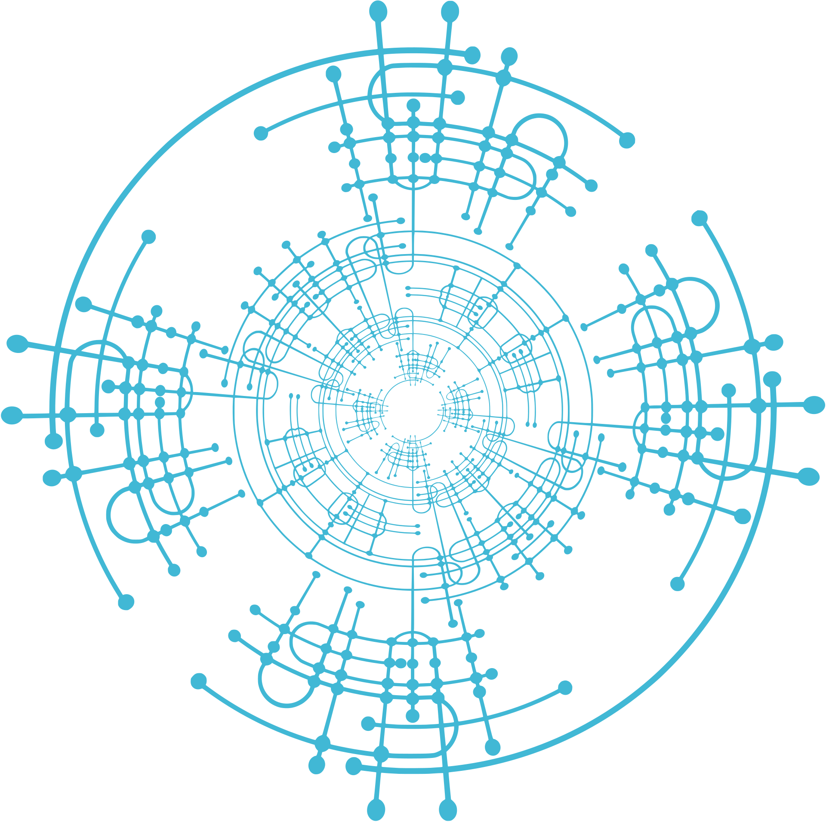
Develop a deep learning pipeline to perform brain tumor segmentation from multi-modal MRI scans.
Utilize the BraTS dataset to train and evaluate segmentation models.
Project Goals

Slide 4

Multi-institutional dataset of glioma patients.
Includes 3D brain MRI scans with 4 modalities:
T1, T1Gd (with contrast), T2, FLAIR
Ground truth masks label tumor sub-regions: edema, necrotic core, and enhancing tumor.
Voxel-wise annotations in NIfTI format (.nii.gz)
Dataset Description

Slide 5

Data Exploration & Visualization
Visualized 2D axial slices across modalities
Overlaid tumor masks to observe affected areas
Explored tumor distribution across slices and patients
Ensured segmentation masks are correctly aligned with MRI scans

Slide 6


Loaded and aligned all modalities (T1, T1ce, T2, FLAIR)
Verified voxel spacing consistency
Applied Z-score normalization for intensity scaling
Checked alignment of tumor masks and identified non-empty slices for training
Preprocessing Pipeline

Slide 7

Model Architecture
Used a 2D UNet (or 3D UNet, if applicable) for segmentation
Input: stacked MRI slices from 4 modalities
Output: voxel-wise tumor mask (multi-class or binary)
Employed Dice loss and Cross-Entropy loss for optimization

Slide 8

Model
Development
Deployed The Working Model on Streamlit
https://sanskarmodi8-brain-tumor-segmentation-app-v4gu5u.streamlit.app/

Slide 9
Split data into training, validation, and test sets
Augmented data with flipping, rotation, and intensity shifts
Training and Evaluation

Slide 10

Model successfully segmented enhancing and edema regions
Testing Accuracy : 99.95 %
Result and Impact

Slide 11
Thank You

